Slide 1
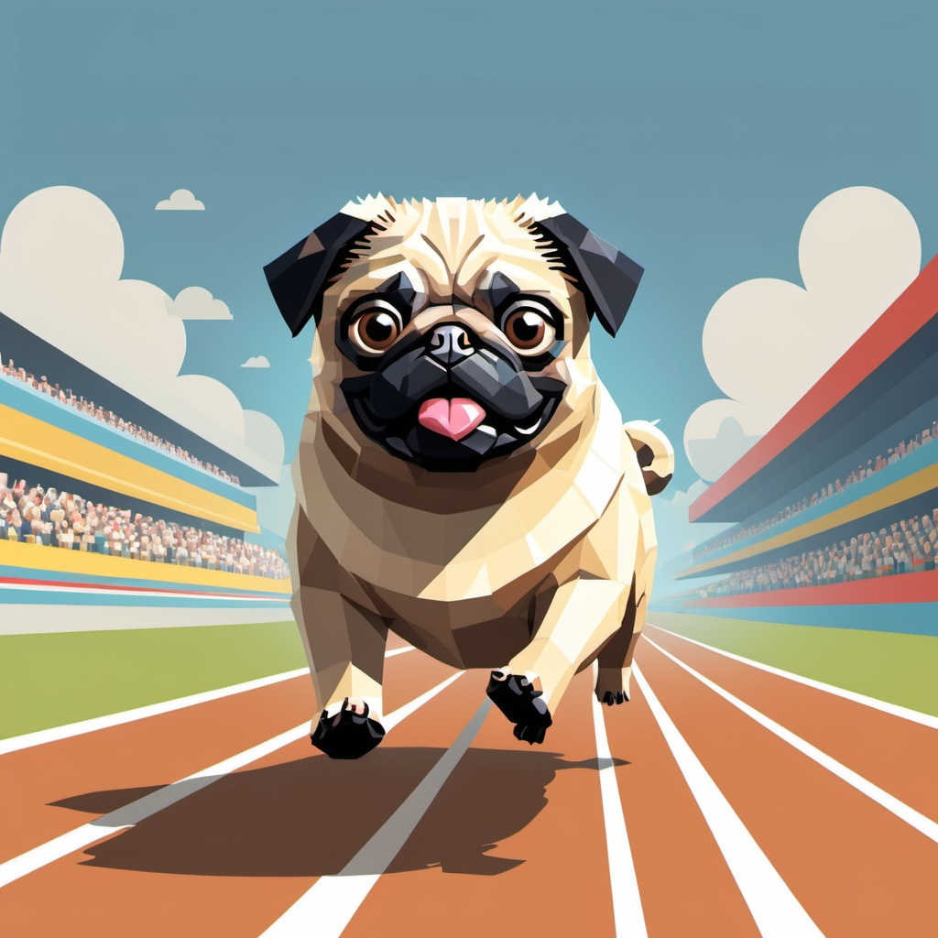
How I train my pug?
Present by:
Guilherme Trentini

Slide 2
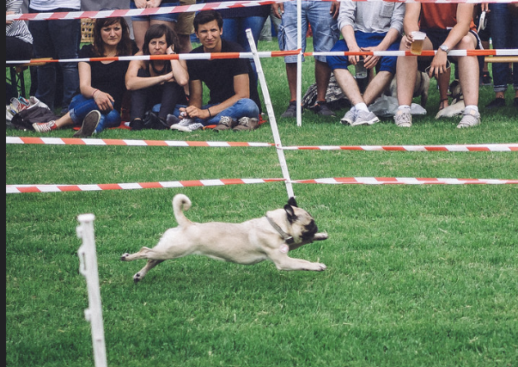
Agenda
Executive Summary
Game Description
Overview
Quest
Main Character – sketch
Opponents – sketch
Environment – sketch
Menus
Controls
Sounds
Summary

Slide 3

Executive Summary
How I Train My Pug? is a fast-paced racing and training game where players train and race their pug in dynamic, obstacle-filled environments. The goal is to guide your pug through a series of levels, mastering skills like dodging, and collecting power-ups to beat your opponents and become the champion of the pug racing.
The game blends casual fun with strategic challenges, with environments like beaches and parks with tracks. During the game you will experience fun sounds, challenging controls and an engaging and family-friendly experience.

Slide 4
Game Description
Overview
Single and multiplayer
Objective: win the race!
Fun environment and animations
Quest
Randomly generated obstacles and “power-ups”
The final objective is to win the "Pug Racing Championship" by dominating the leaderboard.

Slide 5
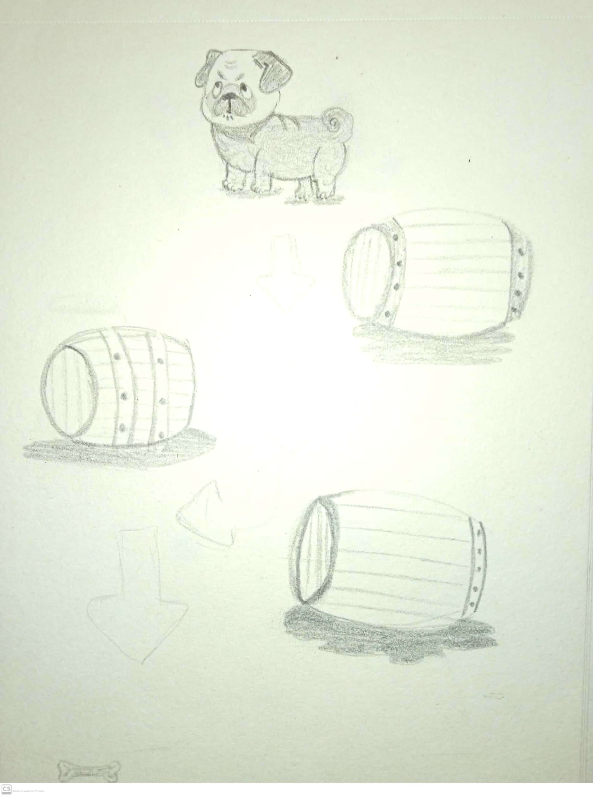
Game Description
Main Character
Pug
Opponnents
The main opponents are the players that will compete against you, using the pug as their main character

Slide 6
Environment
The game features bright and colorful environments designed to be visually appealing and challenging. Levels include:
The Park: A grassy field with scattered trees and can have slippery muds or even snow salt during winter.
The Beach: Sandy paths that can make your pug go slower and beach balls to avoid.

Slide 7
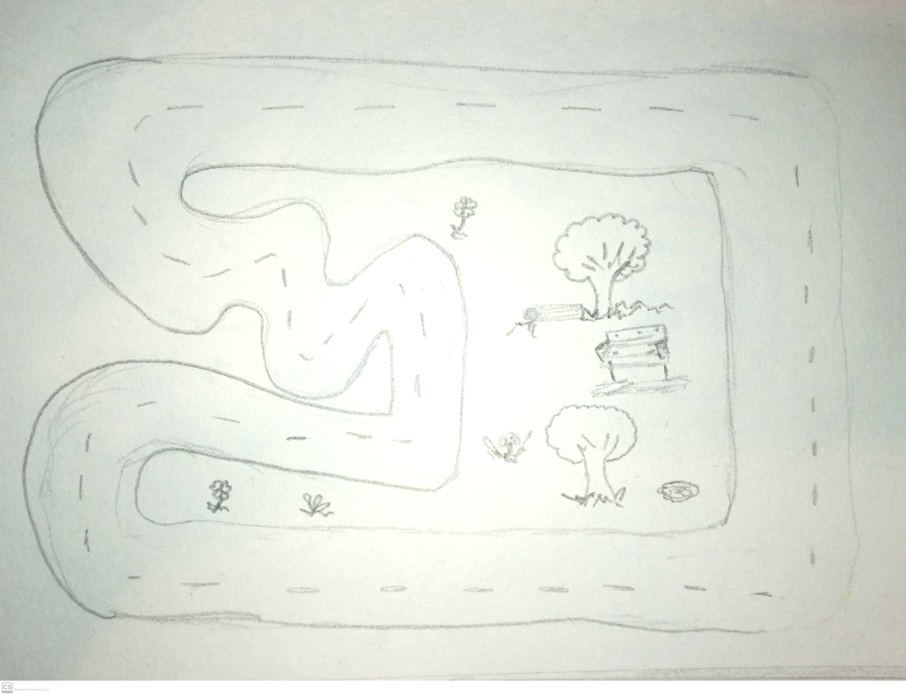
Park

Slide 8
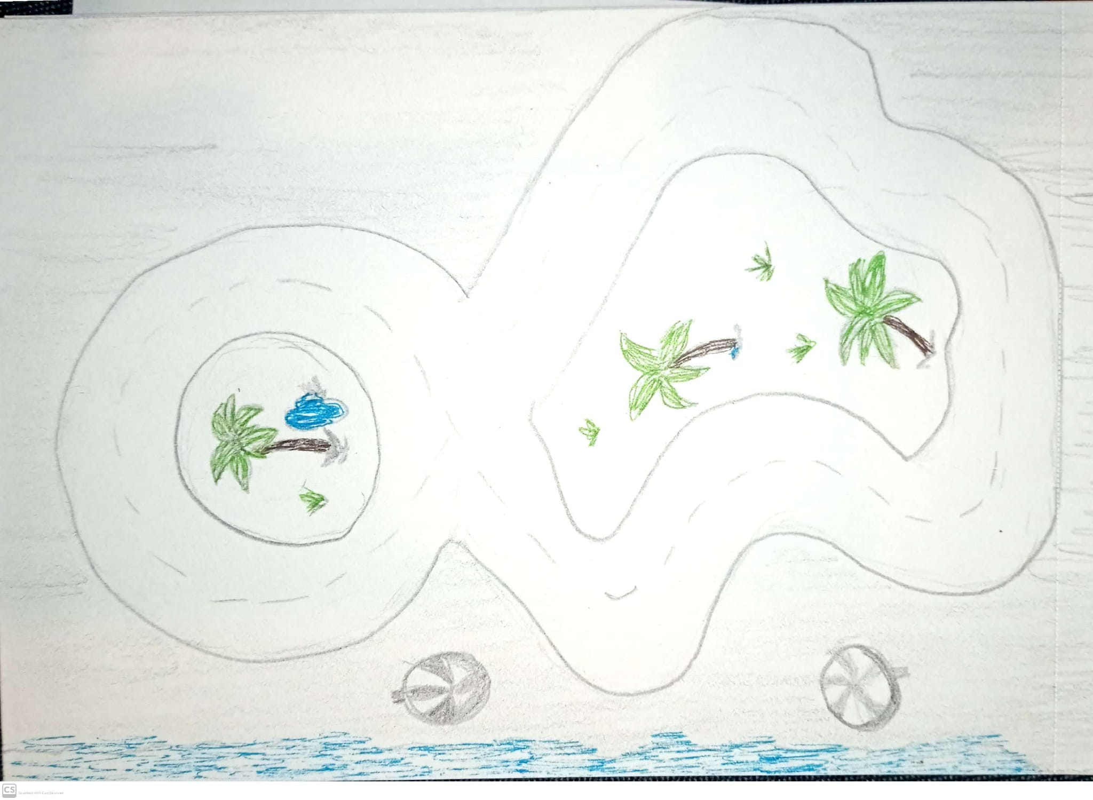
Beach

Slide 9
Menus / Controls / Sounds
Menus
Single-player or multiplayer (2p) options.
Leaderboard: View top players. (Will decide to implement or not)
Controls
Keyboard Layout:
Arrow Keys/WASD: Move.
E: Barks (2 per run)
Sounds
The game features an audio design, including:
Background music: Will be on the start menu before goes to the maps/race.
Sound effects: Pug barks, farts, obstacle collisions, power-up activations, slipperies
Environmental sounds: Waves at the beach, and birds chirping in the park.

Slide 10
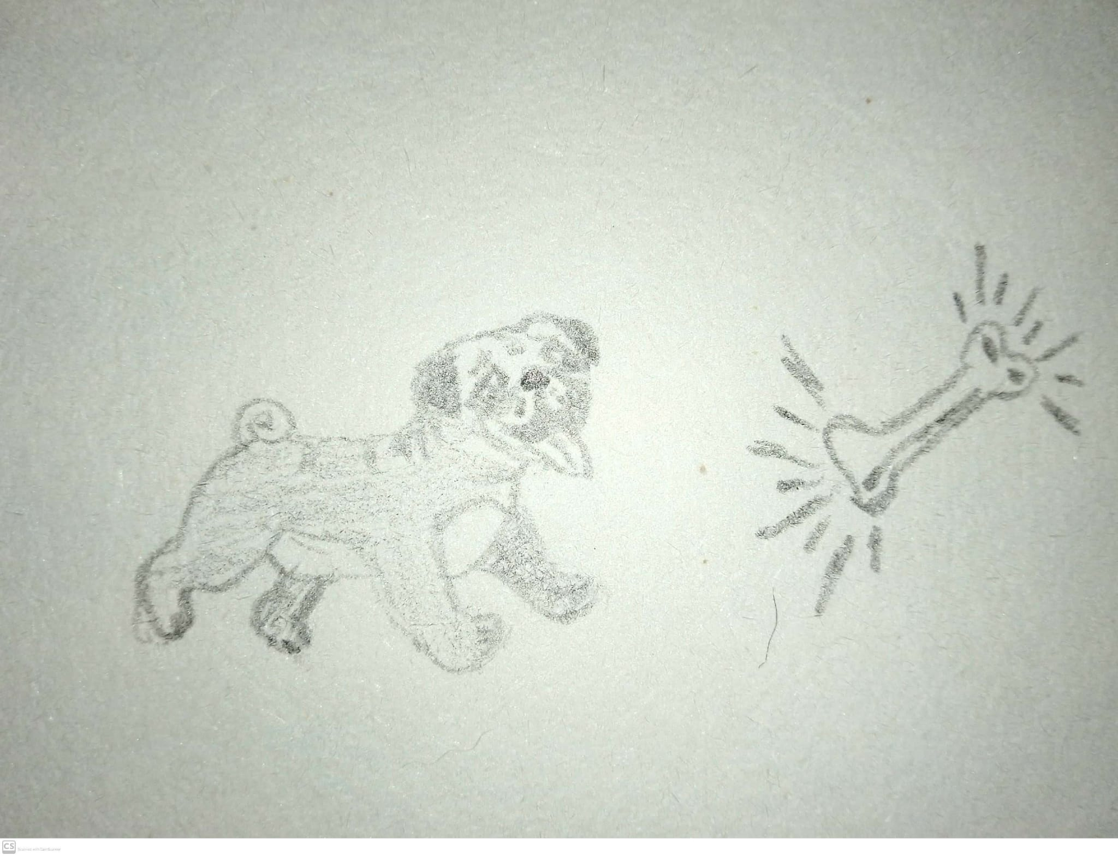
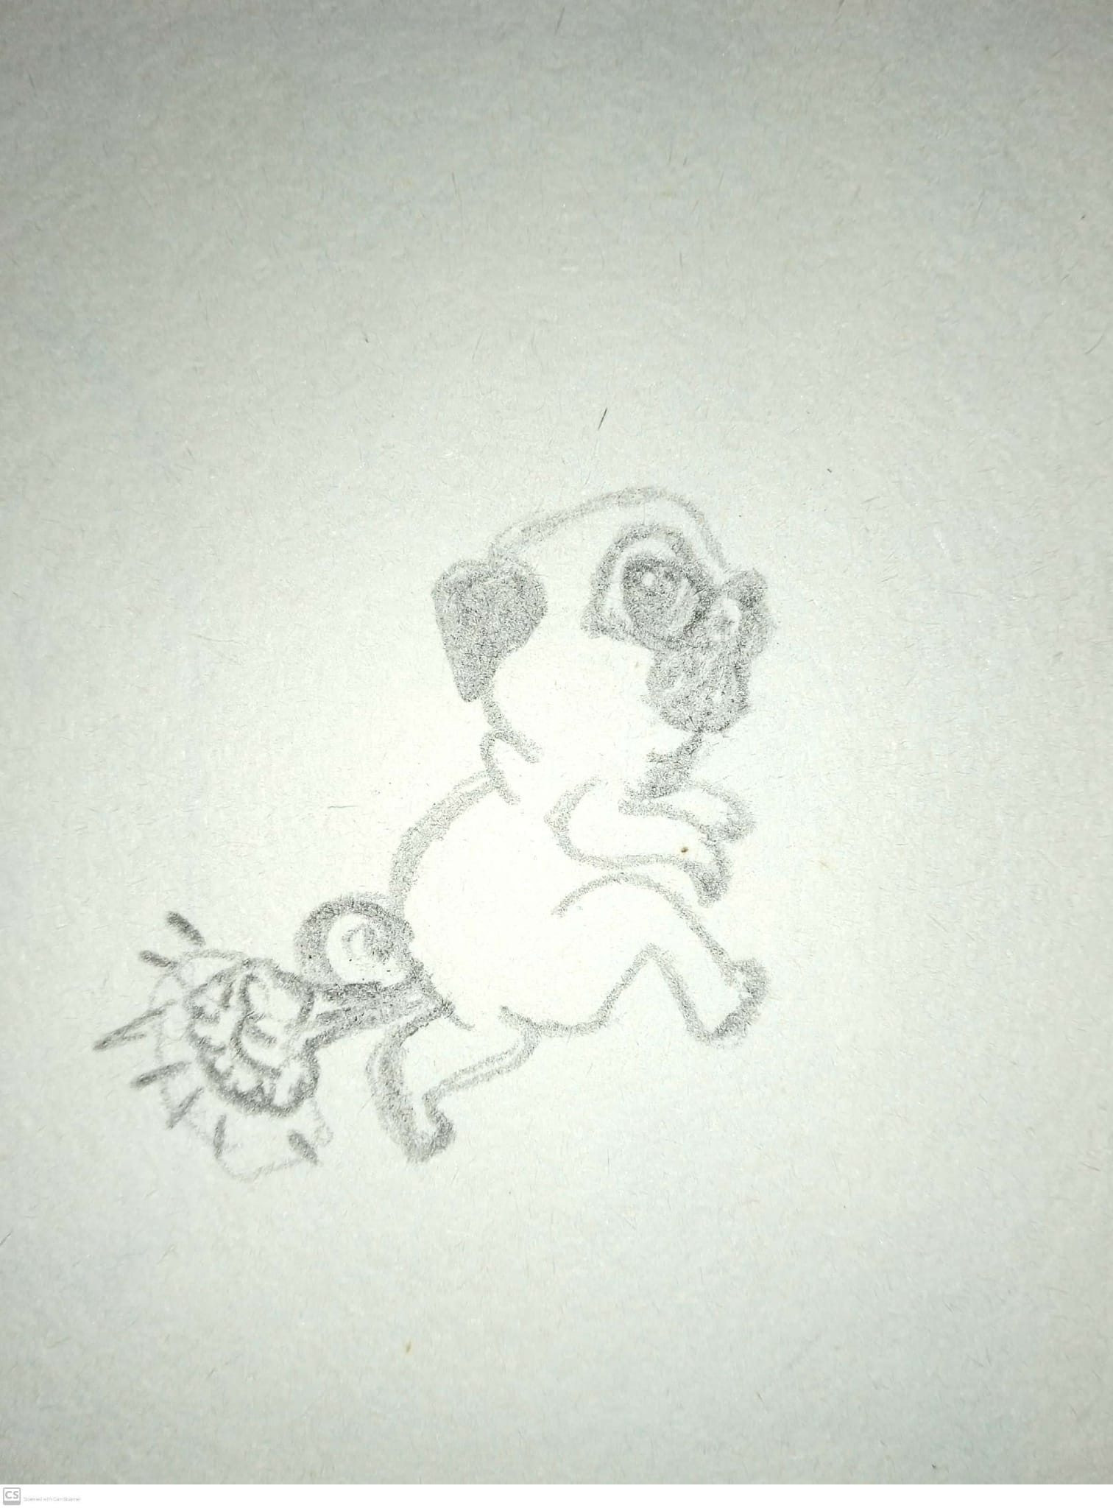
Menus / Controls / Sounds - Sketchs
Accelerating

Slide 11
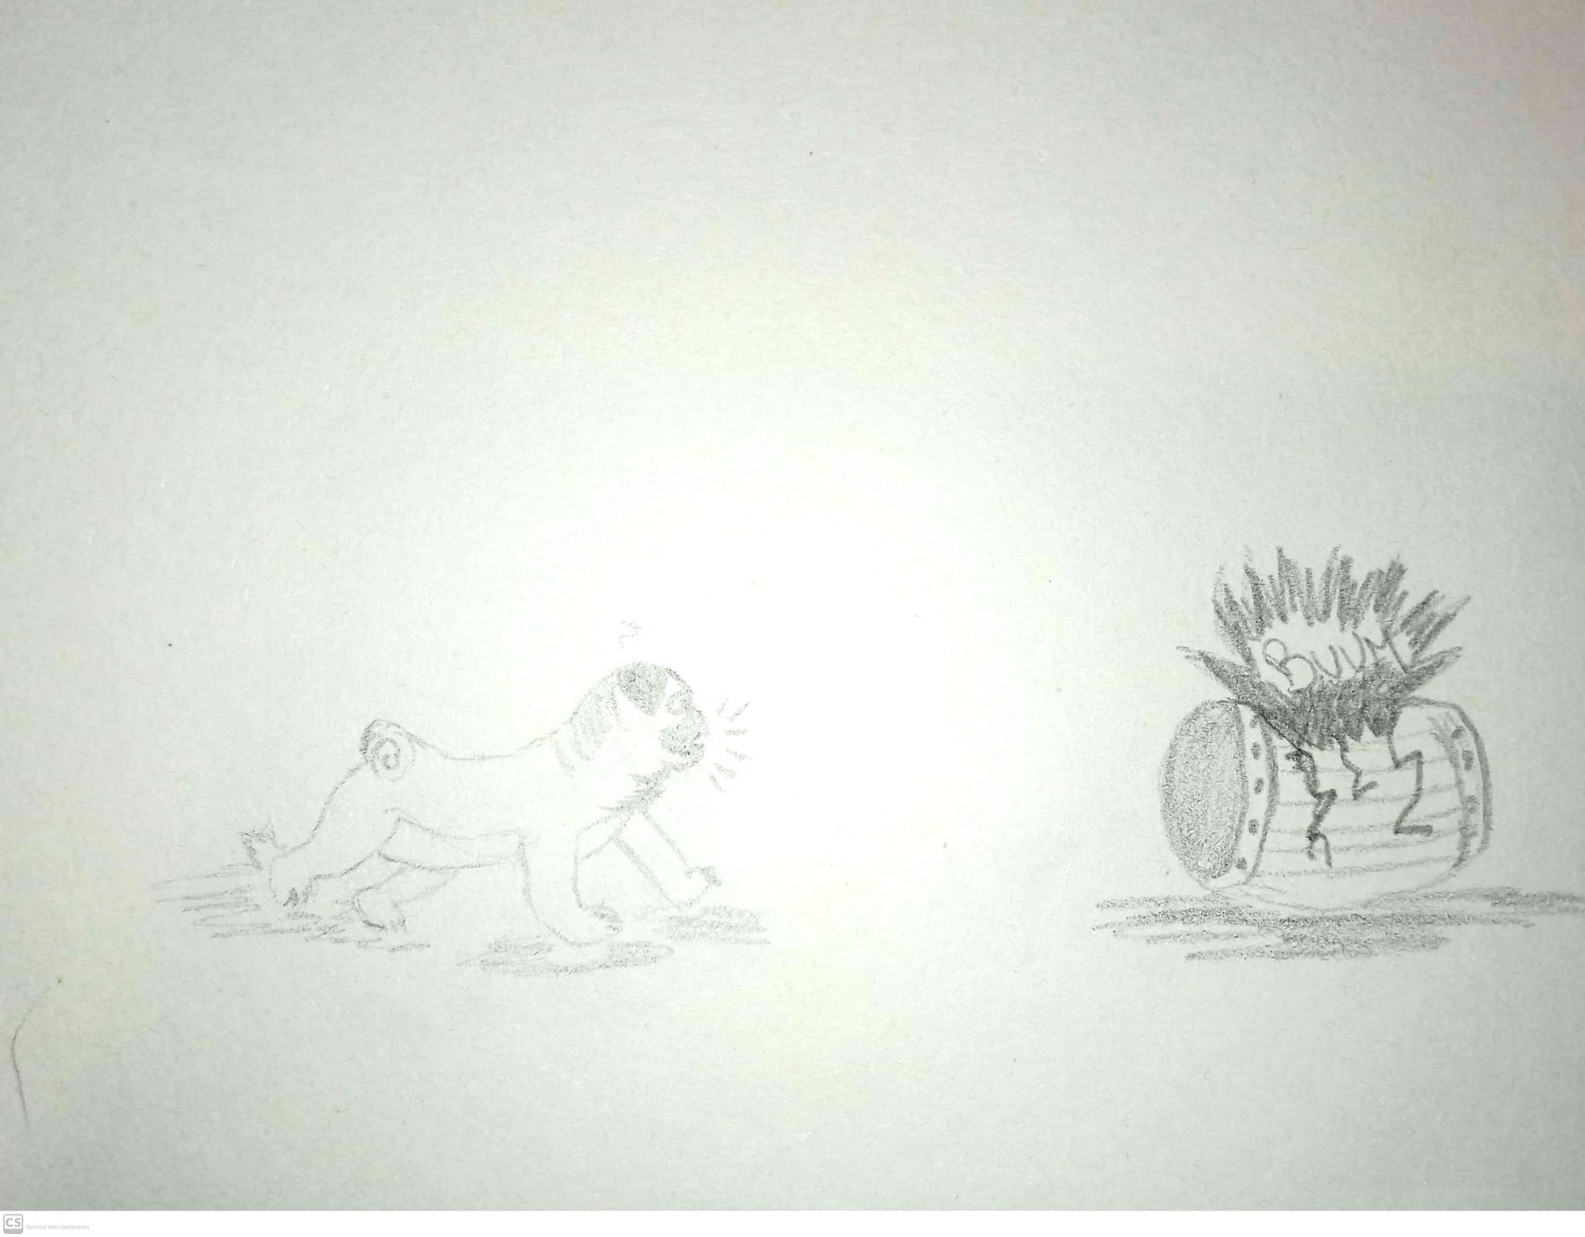
Menus / Controls / Sounds - Sketchs
Barking

Slide 12
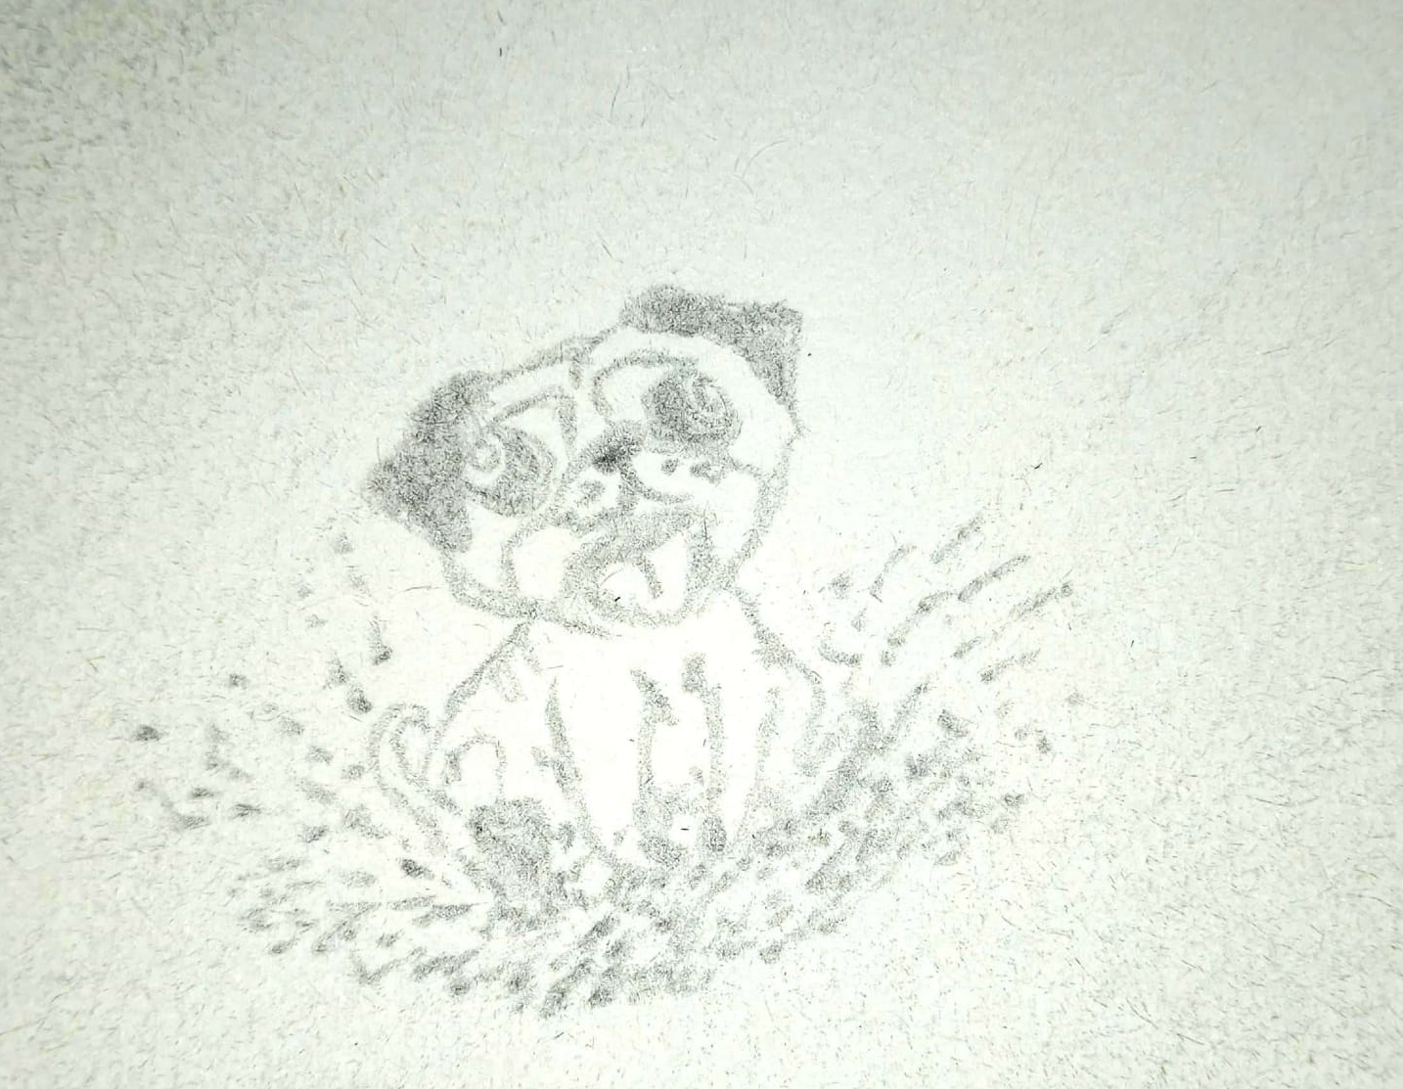
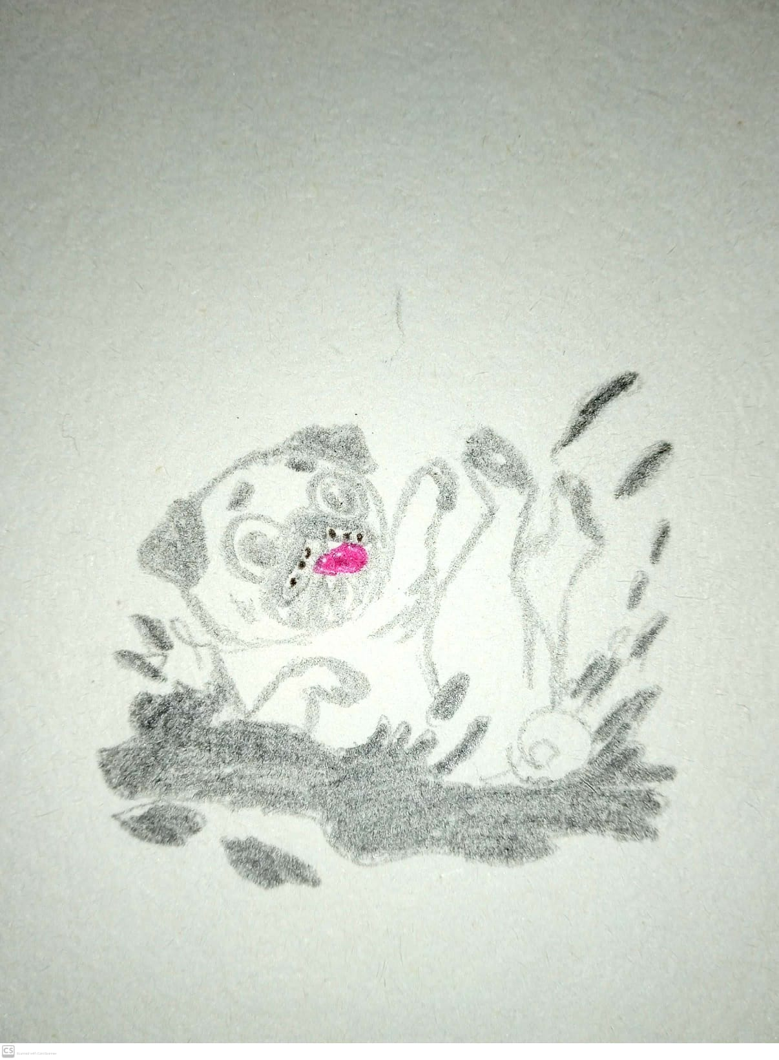
Menus / Controls / Sounds - Sketchs
Slippering – Slows down

Slide 13
Summary
How I Train My Pug? Pug Race is a fun and family-friendly game that combines the thrill of racing with the joy of training an adorable pug. With optional environments, and engaging mechanics, the game appeals to casual players and families. Its unique humor and charm make it a good experience.

Slide 14
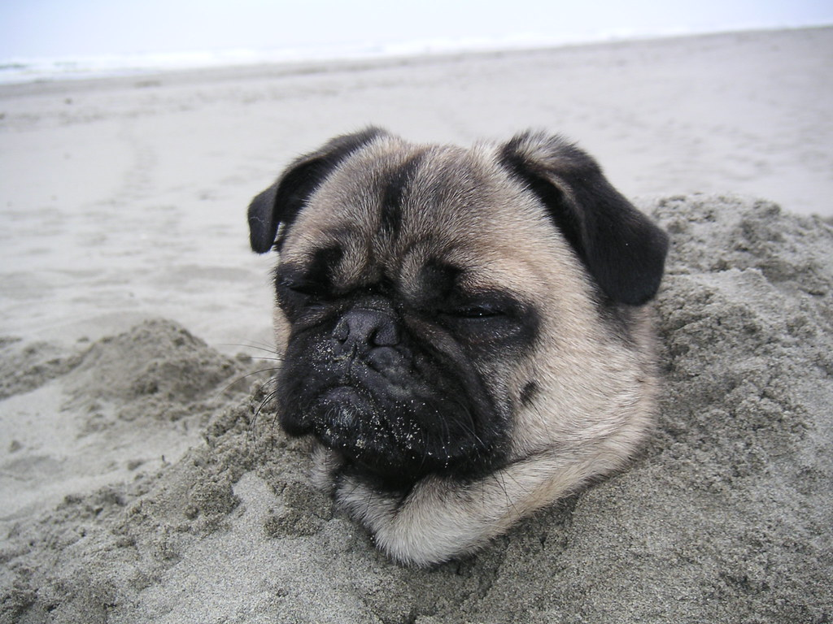
Thank you!

